Slide 1
Alphabet
Year 2

Slide 2
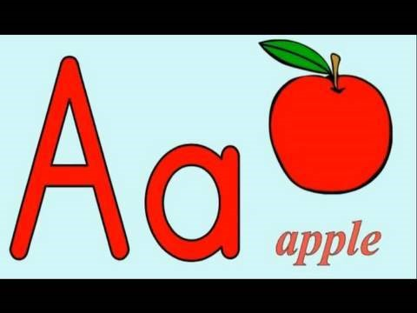
Let’s sing the alphabet song!

Slide 3
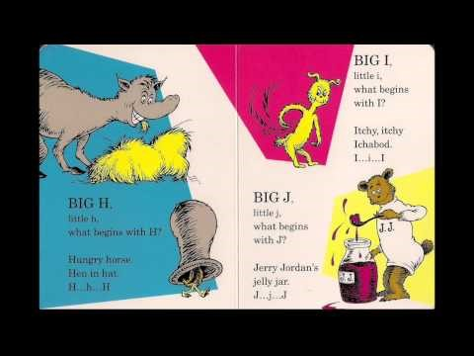
Do you remember this story!

Slide 4

Time to practice writing the letters of the alphabet!
https://www.turtlediary.com/game/write-uppercase-letters.html
https://www.turtlediary.com/game/write-lowercase-letters.html

Slide 5

Concentrate!
Let’s play with letters Aa-Hh!
https://www.quia.com/cc/3112893.html

Slide 6
Let’s play with letters Ii-Pp!
Match the capital with the
small letter!
https://www.quia.com/mc/3112898.html

Slide 7

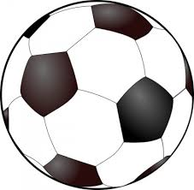
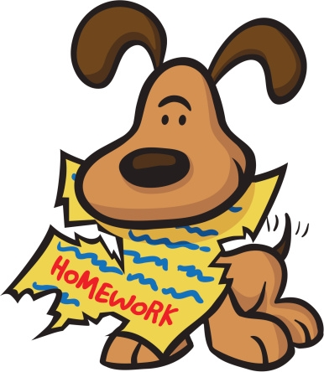
Big B, little b!
What begins with Bb?
Click on the right picture!

Slide 8


Slide 9


Slide 10
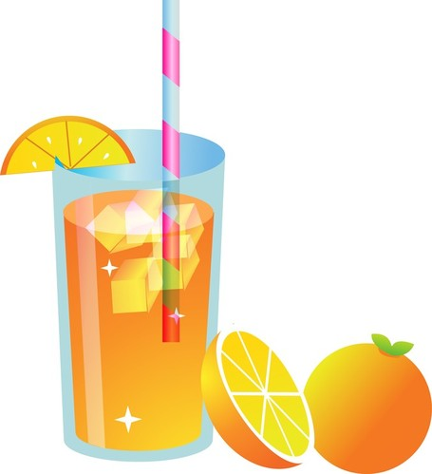
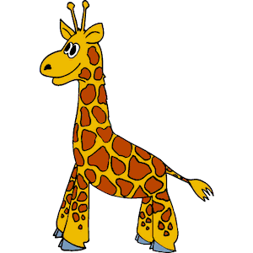
Big G, little g!
What begins with Gg?
Click on the right picture!

Slide 11


Slide 12


Slide 13
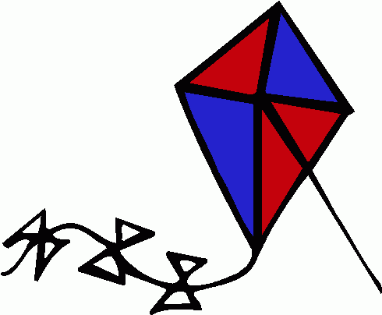

Big C, little c!
What begins with Cc?
Click on the right picture!

Slide 16


Big I, little i!
What begins with Ii?
Click on the right picture!

Slide 19
Now, click on the link
and play
the concentration game!
https://www.funfonix.com/games/intromenu.php

Slide 20
Useful links
https://www.funfonix.com/games/abcmenu.php (Shoot out)
https://www.abcya.com/games/talk_to_me_alphabet
https://www.turtlediary.com/game/matching-upper-and-lowercase-letters.html
https://www.turtlediary.com/game/color-by-letter.html
https://www.turtlediary.com/game/letter-recognition.html
https://www.turtlediary.com/game/what-letter-is-missing.html
https://www.abcya.com/games/kindergarten_alphabet_bingo

Slide 21
Images courtesy of:
https://toppng.com/owl-clipart-cute-owl-clip-art-school-PNG-free-PNG-Images_177232
https://cliparting.com
https://wikiclipart.com
Presentation designed by the English Curriculum Development team,
Cyprus Ministry of Education, Culture, Sports and Youth

